Slide 1
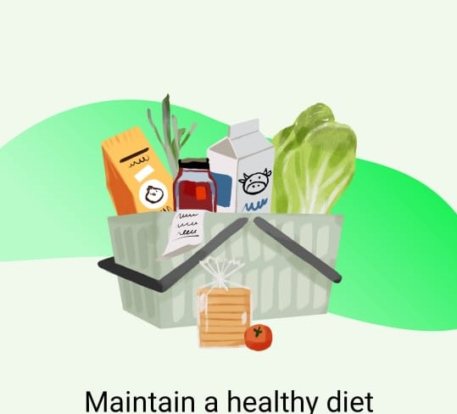
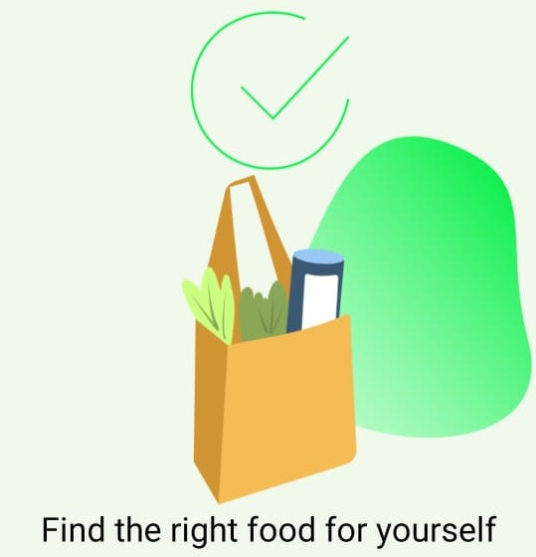
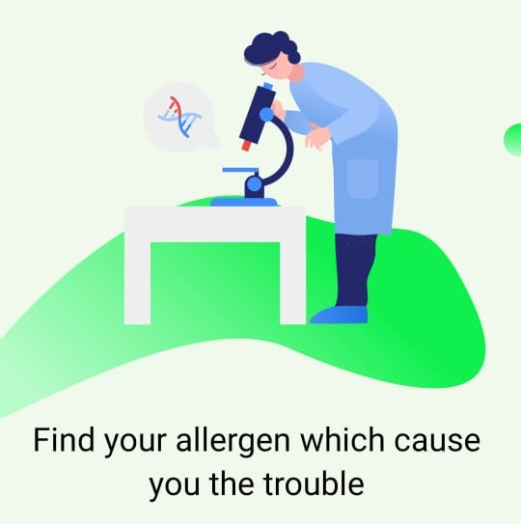
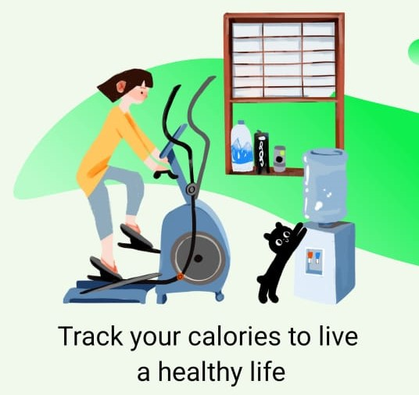
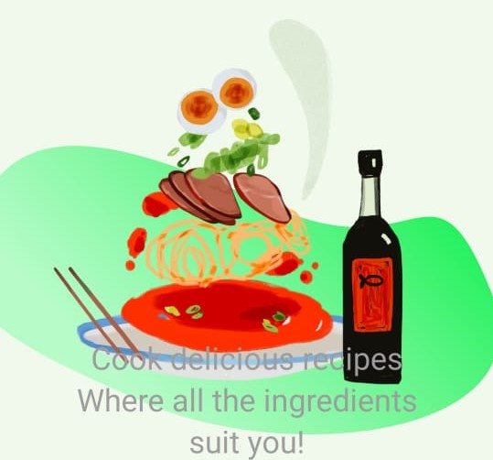
Health App: Food Allergy Prevention, Non-communicable Diseases Prediction, and Calories Tracker
Project ID: 2022-241

Slide 2
Supervisor: Ms. Manori Gamage
Co-Supervisor: Ms. Chathurangika Kahandawaarachchi
Group Members:
Nawarathne I.K.S.S. | IT19213972
Ahamed M.F.A | IT19111070
Muhassan Faizal | IT19212050
Chirathma V G B | IT19218090

Slide 3
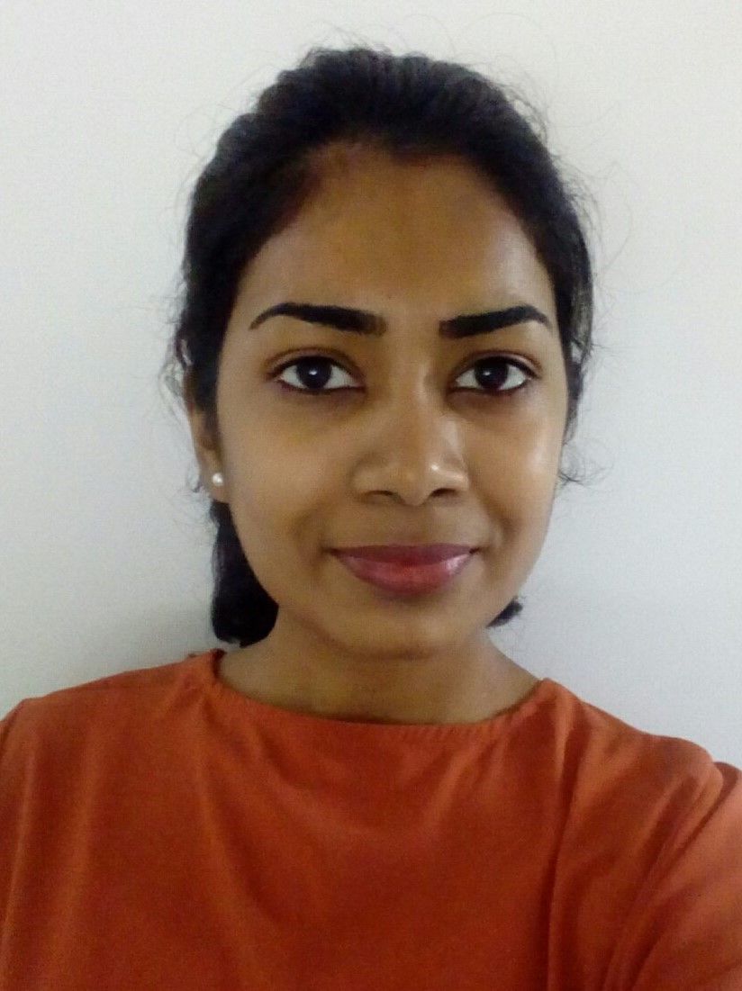
Nawarathne I.K.S.S. | IT19213972
Individual Component:
Prediction of the user’s Allergy and Allergens that caused the Allergy by analyzing the Symptoms and Food Items entered by the user

Slide 4
Overall Component Explained
The overall strategy of my component is centralized with the user. As per the methodologies and processes mentioned above, this is ideal for those unaware of their allergies and allergens. The planned system shall have User Interfaces to enter the food items consumed within 12 hours (Assuming he has a food allergy). According to the sources, the allergic reaction symptoms of a food allergy may occur between a few minutes and two hours after exposure to the food item. The next step shall include the symptoms tracking process. The user may already have some symptoms due to an allergic reaction concerning the above theorem. Therefore, the following interface shall have a list of symptoms, and the user can select the symptoms they might have felt that day. These symptoms will be filtered upon entering the food items.
After analyzing these entered details, the system shall predict the allergen/food item/ food type that caused the allergy. These records will be taken into consideration because tracking both the food intake and allergy symptoms makes it much easier to figure out what is causing the allergies and the outcome of the allergic reactions. Since it will take 1 to 3 weeks to entirely vanish the signs of an allergic reaction, the user should continue the process for at least three weeks to get the most out of the proposed application. During this time, the user can eliminate the system-predicted food items from the diet plan and follow the tips and precautions/remedies provided through the application to stay healthy and free from Food Allergies
IT19213972 | Nawarathne I.K.S.S | 2022-241 | Progress presentation1

Slide 5
Objectives
The main objective of implementing this component is to detect and predict food allergy and the allergens caused the allergy by analyzing the food items consumed, tracking prevailing signs and symptoms entered by the user within 12 hours, for three weeks.
Specific Objectives:
Elimination of Allergens - It is likely to be affected if frequently consumed food items are within the 'big eight'; the eight food groups responsible for 90% of food allergy reactions. Once the food item is predicted, it can be eliminated. This elimination of Allergens involves removing a particular food from the user's diet for two weeks.
Symptom Tracking - The user can select their prevailing symptoms from a list of medical symptoms provided through the app (medical symptoms will be filtered concerning the food items entered into the system) and record them as part of the prediction. Users can record the details as needed in the symptoms section of check-in for three weeks.
IT19213972 | Nawarathne I.K.S.S | 2022-241 | Progress presentation1

Slide 6
Objectives
3. Informed decision making - The user can become an active participant in any Allergy-healthcare decision, feeling empowered to discuss procedures, self-diagnoses, and treatments with various healthcare specialists as the app provides 95% accurate medical decisions.
4. Generation of PDF reports - The reports may contain information such as the system predicted food item/allergens, symptoms entered by the user, any other relevant symptoms (detected by the application itself), the system predicted allergy, quick remedies to be taken, and outcomes. These reports can help users discover triggers or help them stay on track to minimize symptoms based on the allergy & allergens.
IT19213972 | Nawarathne I.K.S.S | 2022-241 | Progress presentation1

Slide 7
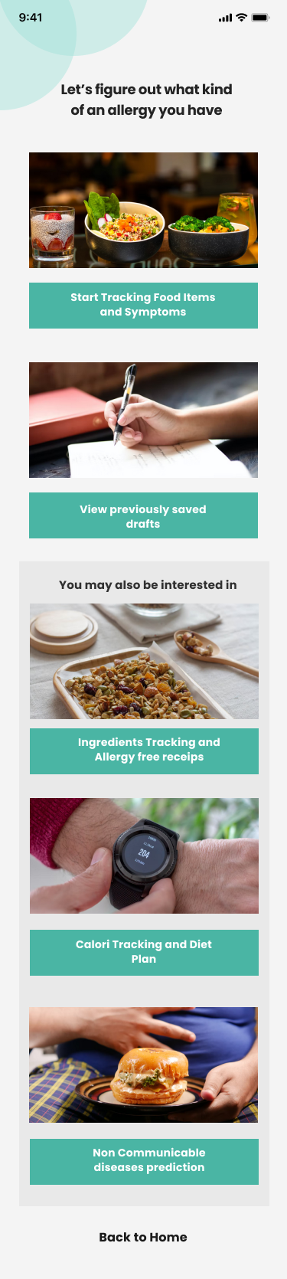
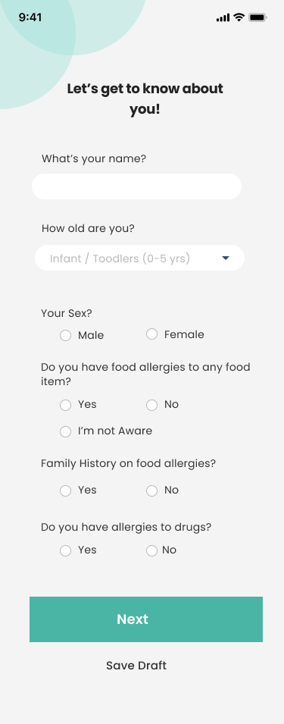
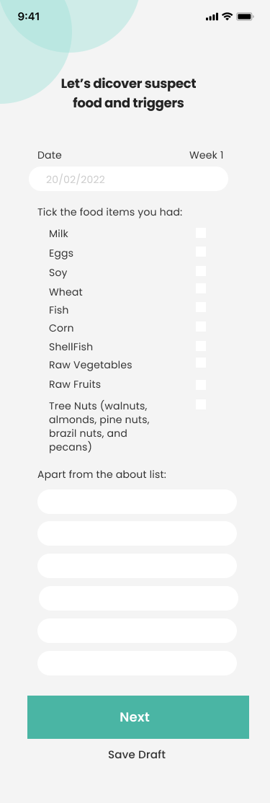
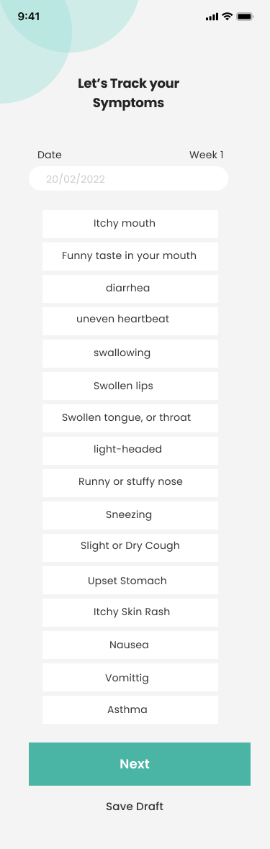
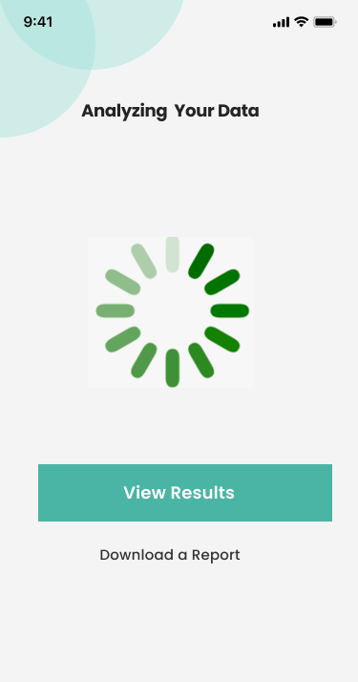
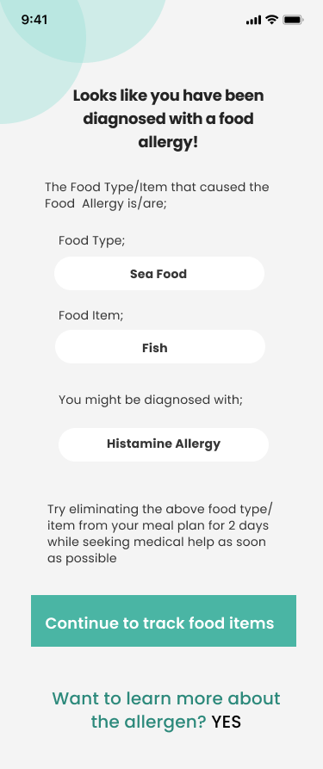
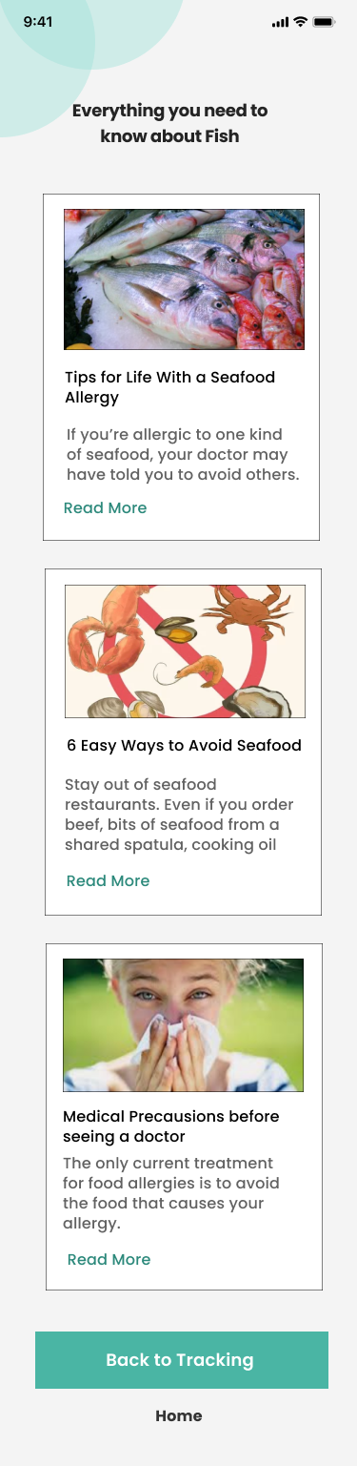
Figma Prototypes of the User Interfaces
Analyzing Data
OutPut
Component
Landing Page
Bio Check-up
Suspect Food
Checkup
Symptoms
Tracking

Slide 8
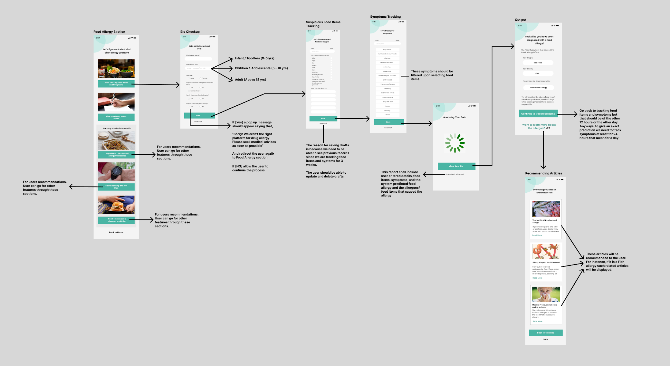
Interface Flow
IT19213972 | Nawarathne I.K.S.S | 2022-241 | Progress presentation1

Slide 9
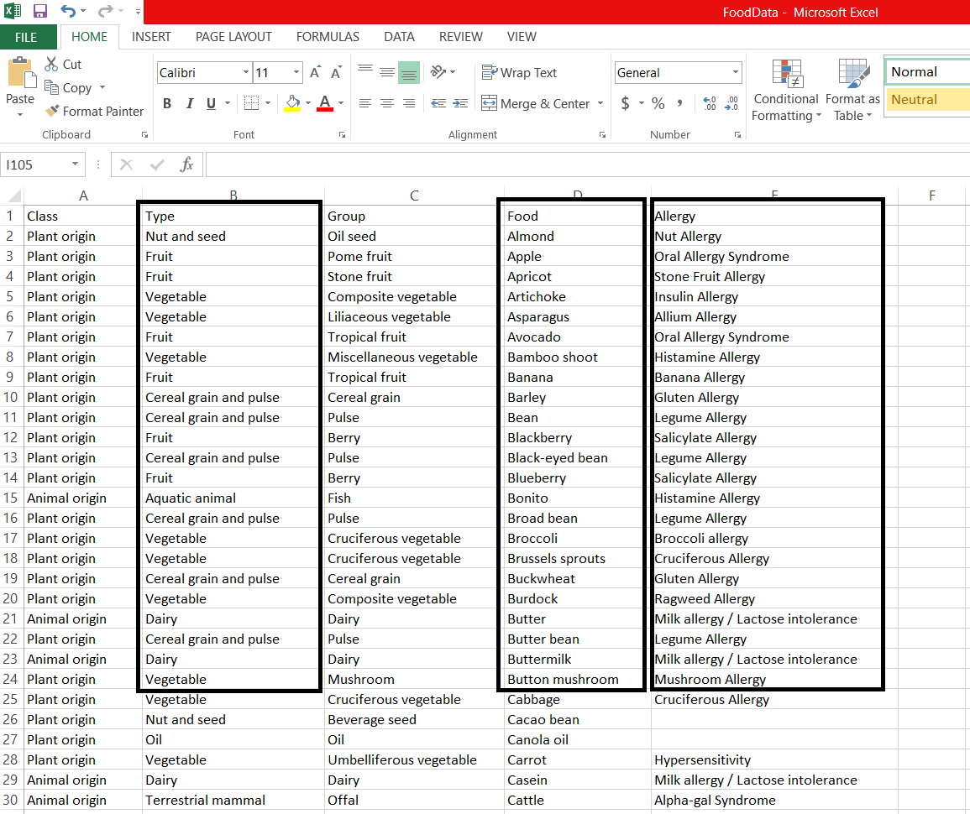
Data Set (cont.)
Finding a proper dataset was quite a challenging task. I searched Kaggle, Google scholar, and many other sites for a dataset related to food allergies and relevant food items. Luckily I found a dataset that includes several food items and the medical/identical name for the allergy caused by the given food type. I extracted three columns from that dataset and prepared the my dataset with the help of our external supervisor Dr. Ridmika Senevirathne and her colleague Gayani Perera, a nutritionist.
Data columns which were taken from Kaggle dataset are: Food Type, Food Item and Allergy
Food data: Resource; Kaggle
IT19213972 | Nawarathne I.K.S.S | 2022-241 | Progress presentation1

Slide 10
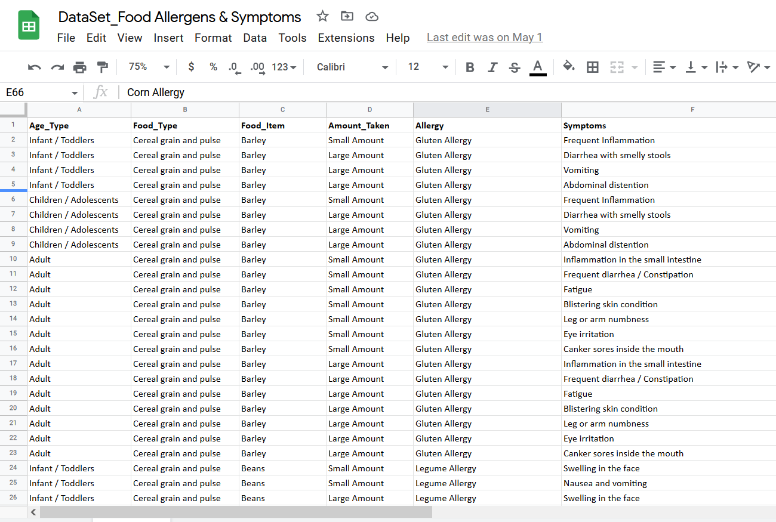
Data Set
For a better accuracy and easiness, I have taken 3 main age types as follows,
Infant / Toddlers (0 - 5 yrs)
Children / Adolescents (5 - 18 yrs)
Adult (above 18 yrs)
Also, when predicting the allergen we have to consider the amount of the food item taken. Therefore the “Amount Taken” will also be taken as an user input when doing a bio checkup.
Prepared Dataset
IT19213972 | Nawarathne I.K.S.S | 2022-241 | Progress presentation1

Slide 11
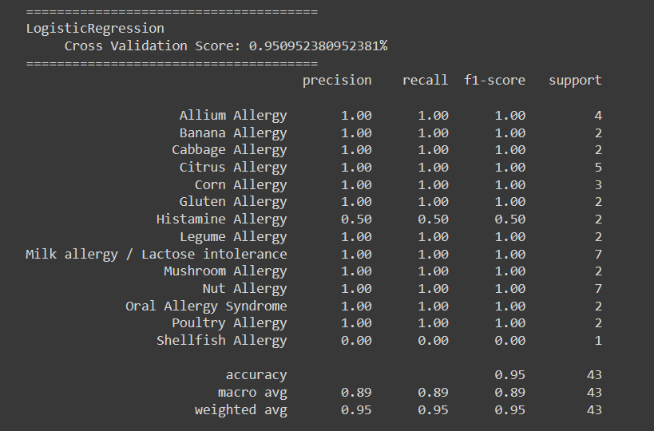
Model Selection
Five main models were taken into consideration.
LogisticRegression
KNeighborsClassifier
RandomForestClassifier
DecisionTreeClassifier
GaussianNB
Model selection using LogisticRegression
IT19213972 | Nawarathne I.K.S.S | 2022-241 | Progress presentation1

Slide 12


Model selection using KNeighborsClassifier
Model selection using RandomForestClassifier
IT19213972 | Nawarathne I.K.S.S | 2022-241 | Progress presentation1

Slide 13
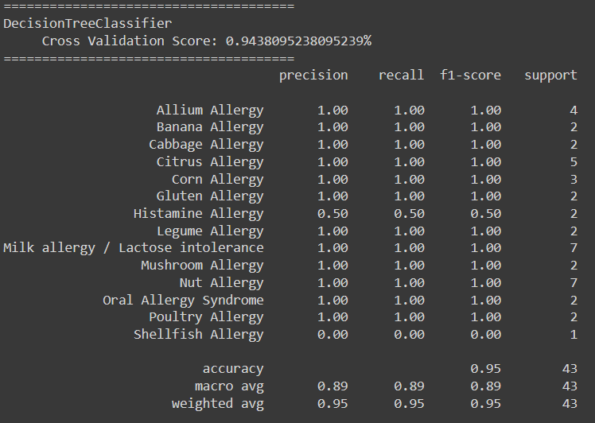
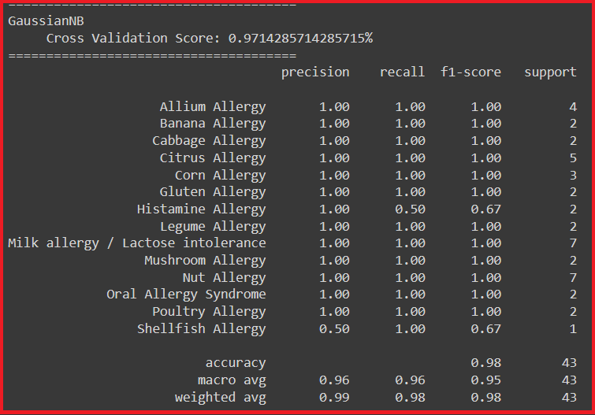
Model selection using DecisionTreeClassifier
Model selection using GaussianNB
IT19213972 | Nawarathne I.K.S.S | 2022-241 | Progress presentation1

Slide 14
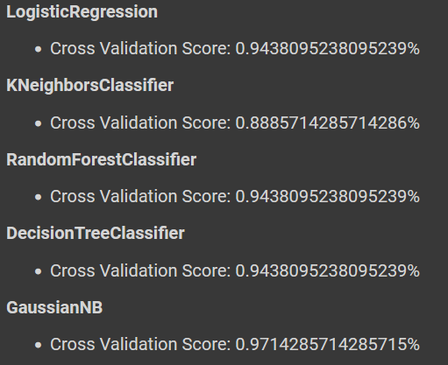
Model Selection (cont.)
F1-Score: A good F1 score means that you have low false positives and low false negatives, so you're correctly identifying real threats and you are not disturbed by false alarms. An F1 score is considered perfect when it's 1
Precision: should ideally be 1 (high) for a good classifier
Recall: should ideally be 1 (high) for a good classifier
IT19213972 | Nawarathne I.K.S.S | 2022-241 | Progress presentation1

Slide 15
Model Selection - Food Allergy Prediction
Cross-validation, F1 Score, Precision, and Recall is primarily used in applied machine learning to estimate the skill of a machine learning model on unseen data. According to the evaluation LogisticRegression, RandomForest, and GaussianNB classifiers performed well. By considering the cross validation score and other factors, GaussianNB was chosen for final model.
IT19213972 | Nawarathne I.K.S.S | 2022-241 | Progress presentation1

Slide 16
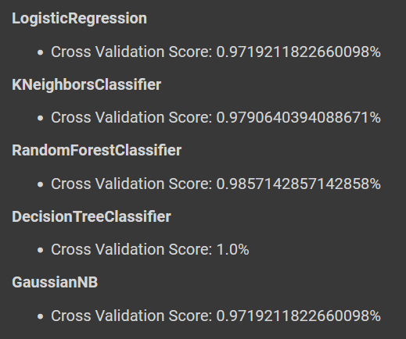
Model Selection - Food Type Prediction
Cross-validation, F1 Score, Precision, and Recall is primarily used in applied machine learning to estimate the skill of a machine learning model on unseen data. According to the evaluation Tree-Based Classifiers performed well. So, DecisionTreeClassifier was chosen for final model.

Slide 17
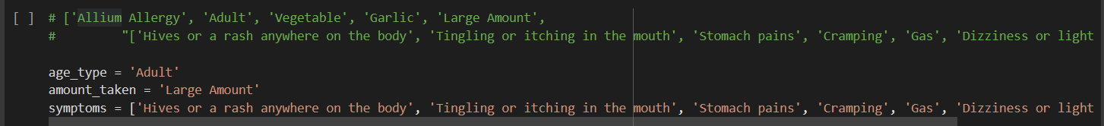
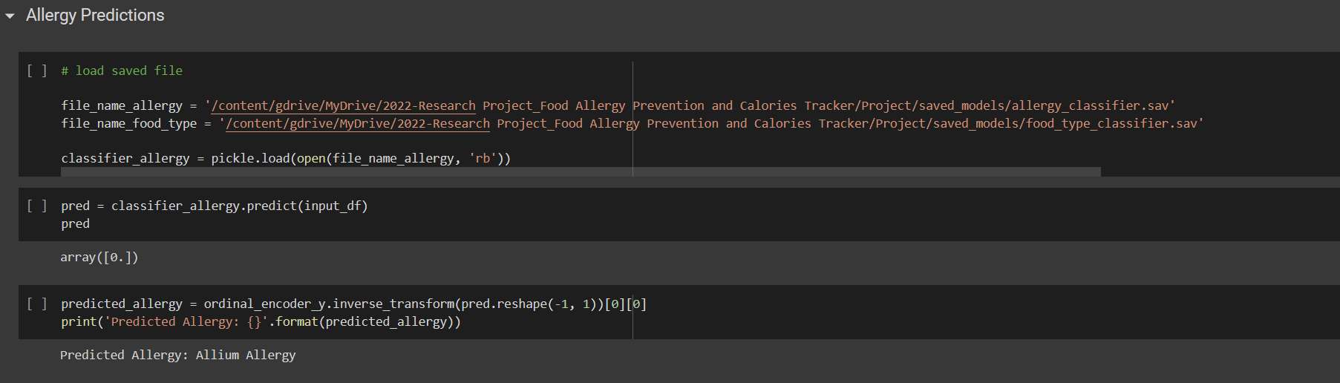
Real World Test

Slide 18
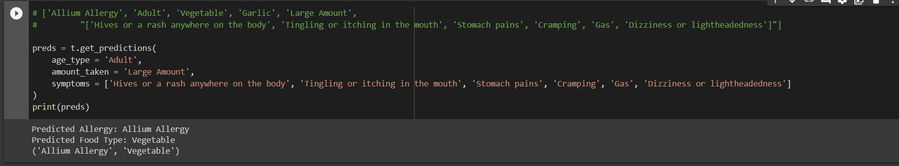
For now, only the food allergy and the food type is predicted. I’m planning on implementing food item prediction also.

Slide 19
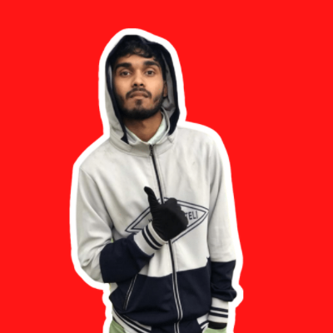
Ahamed M.F.A | IT19111070
Individual Component:
Allergy Free Recipe and Food Restriction App

Slide 20
Research Problem
Food Lovers Who have Allergy wants to taste the food Everyone enjoying
People want safety Food Recipes which not go against their beliefs
Connecting the people with same allergy
IT19111070 | M.F.A Ahamed | 2022-241 | Progress presentation1

Slide 21
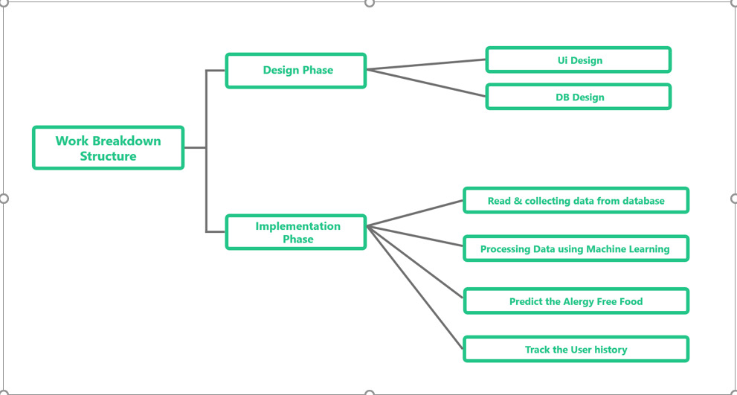
Work Breakdown Structure
IT19111070 | M.F.A Ahamed | 2022-241 | Progress presentation1

Slide 22
Technologies Used
React Native 4. Nodejs
Machine Learning 5. Python
Firebase
Application of Technologies
Firebase | Realtime database. Managing The Forum Discussion
Machine Learning | Processing the data set and classify the food recipes
React native | Creating mobile app and the Interfaces
Node.js | Will be used to develop Backend functions
IT19111070 | M.F.A Ahamed | 2022-241 | Progress presentation1

Slide 23
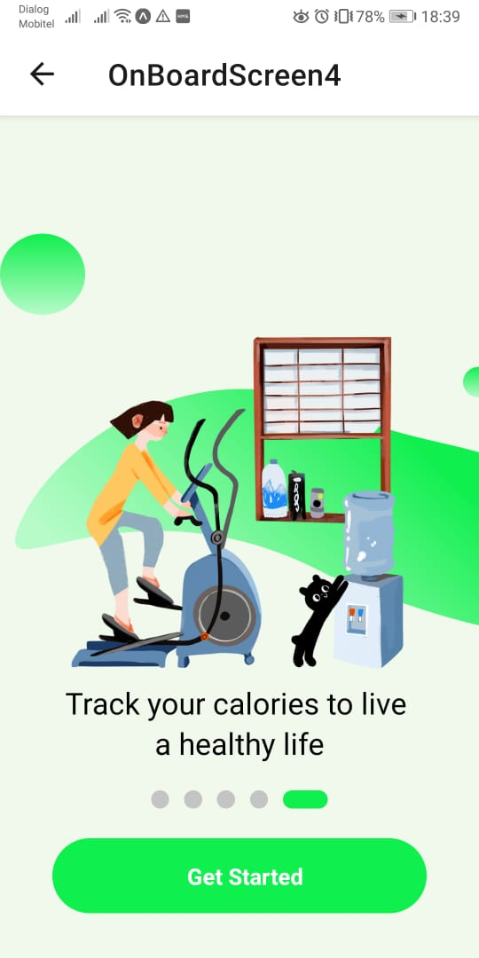
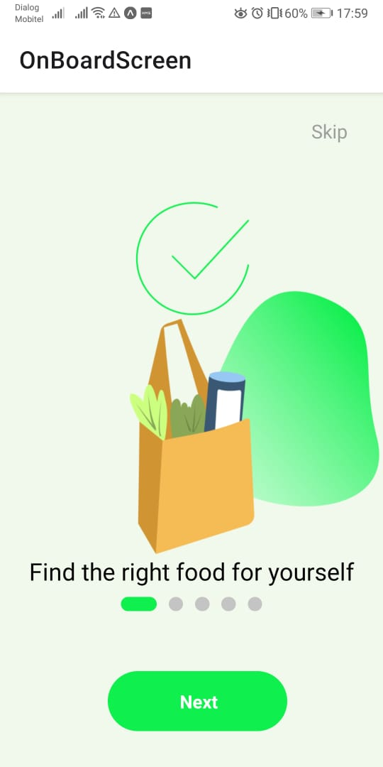
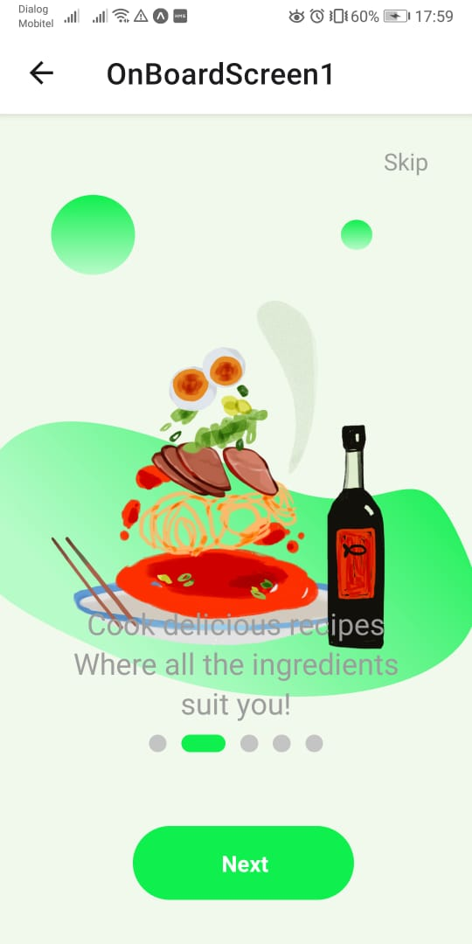
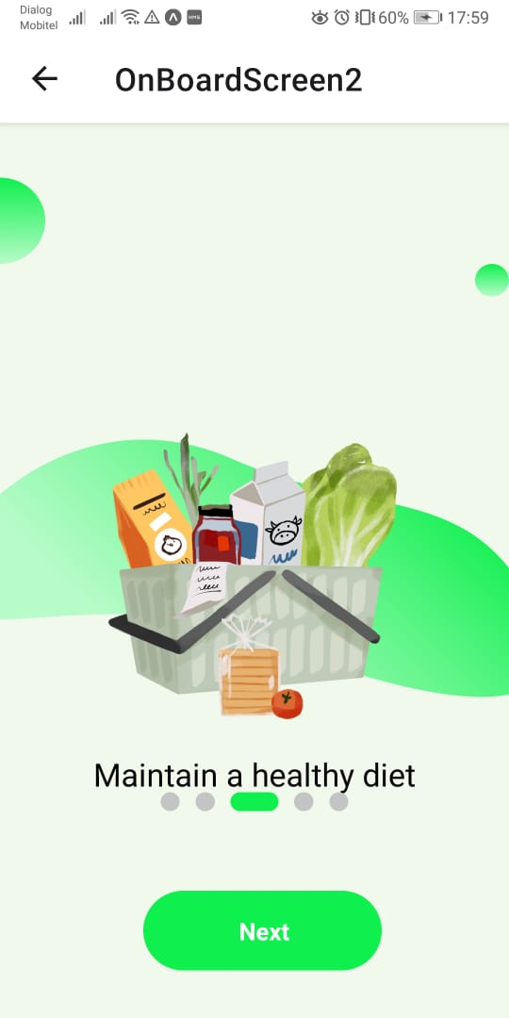
User Interfaces - React Native
IT19111070 | M.F.A Ahamed | 2022-241 | Progress presentation1

Slide 24
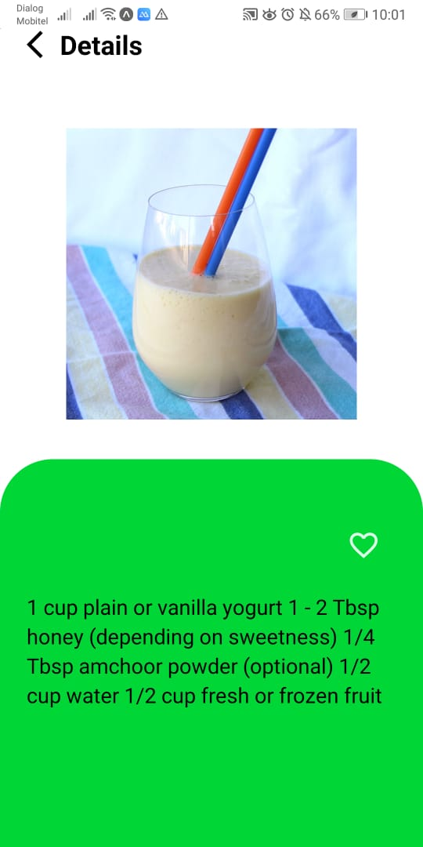
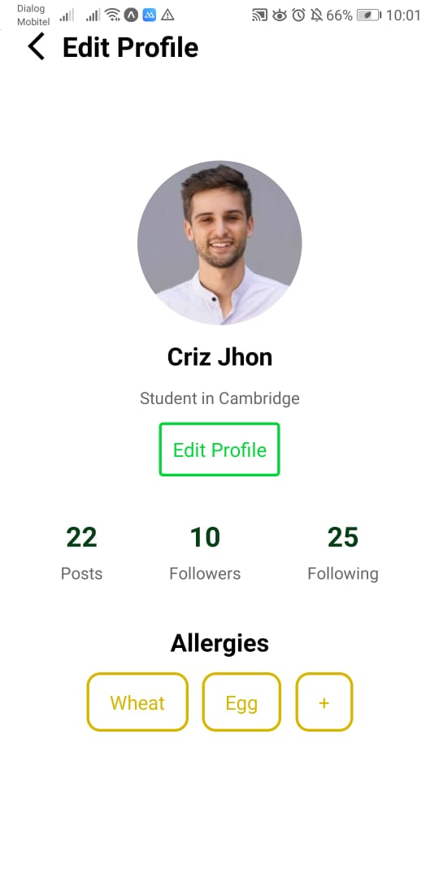
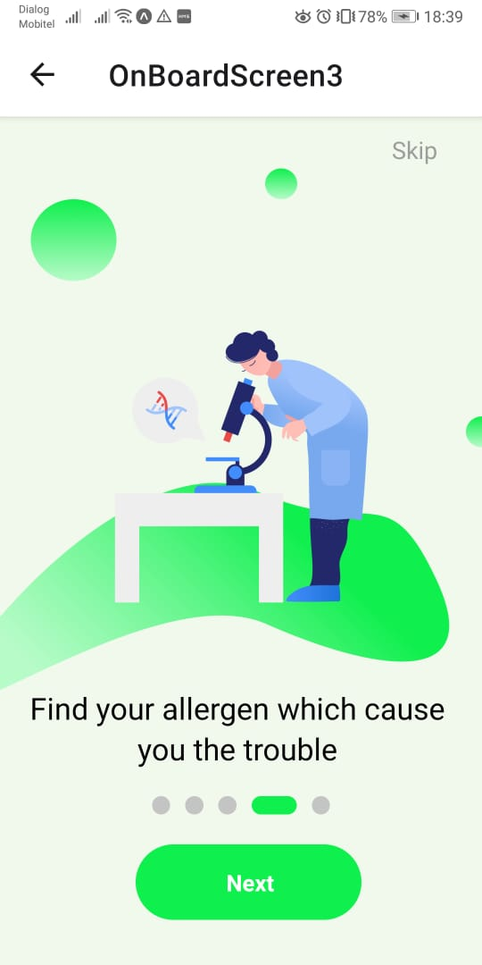
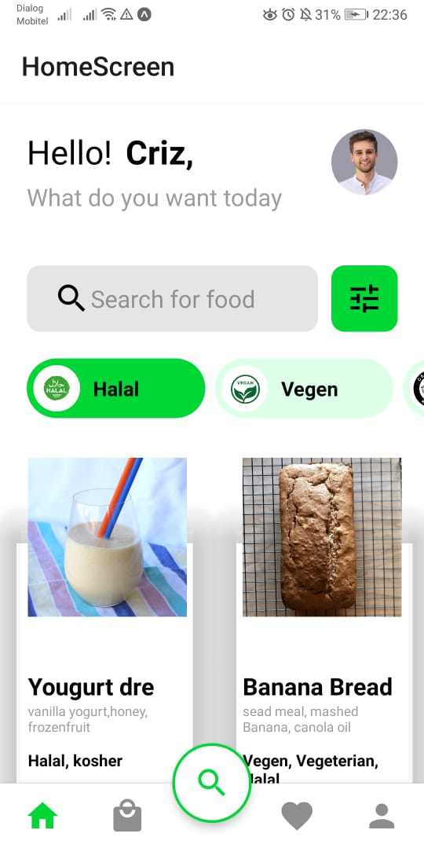
User Interfaces - React Native
IT19111070 | M.F.A Ahamed | 2022-241 | Progress presentation1

Slide 25
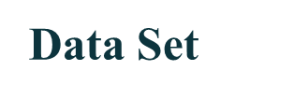
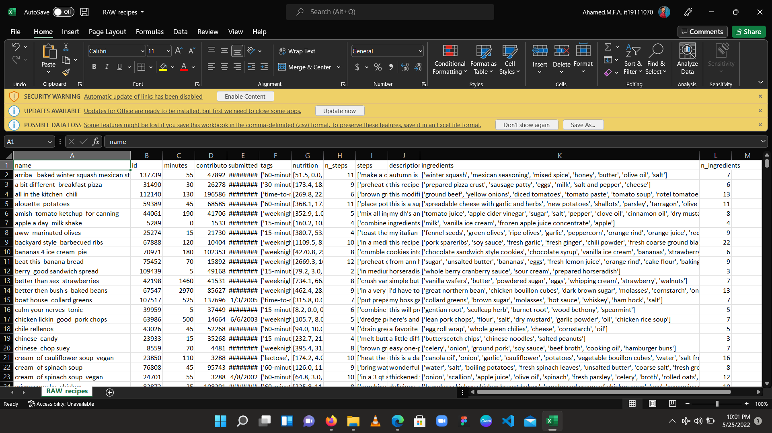
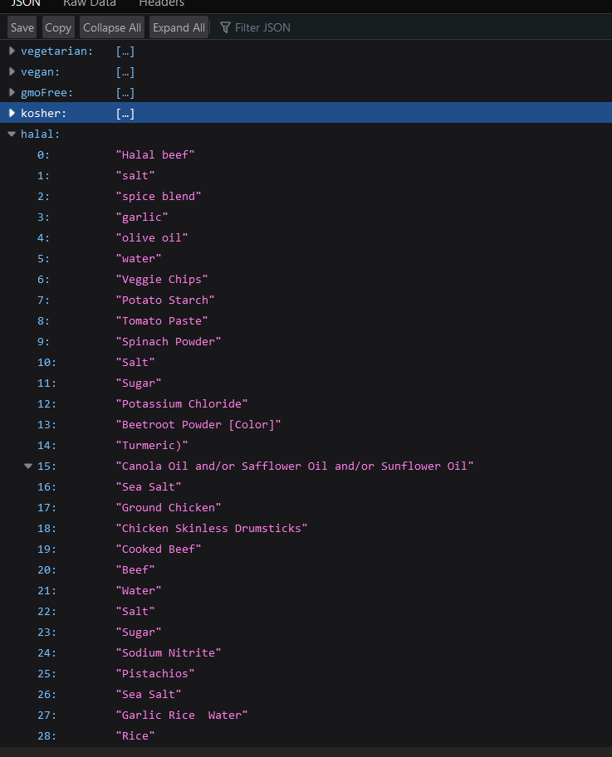
Data set which is needed for my component is Foods with recipes and i have searched in many websites and found the data set from KEGGLE and its really page scrapped datas Food.com website
This recipes are with user reviews
Recipes have the calories
IT19111070 | M.F.A Ahamed | 2022-241 | Progress presentation1

Slide 26
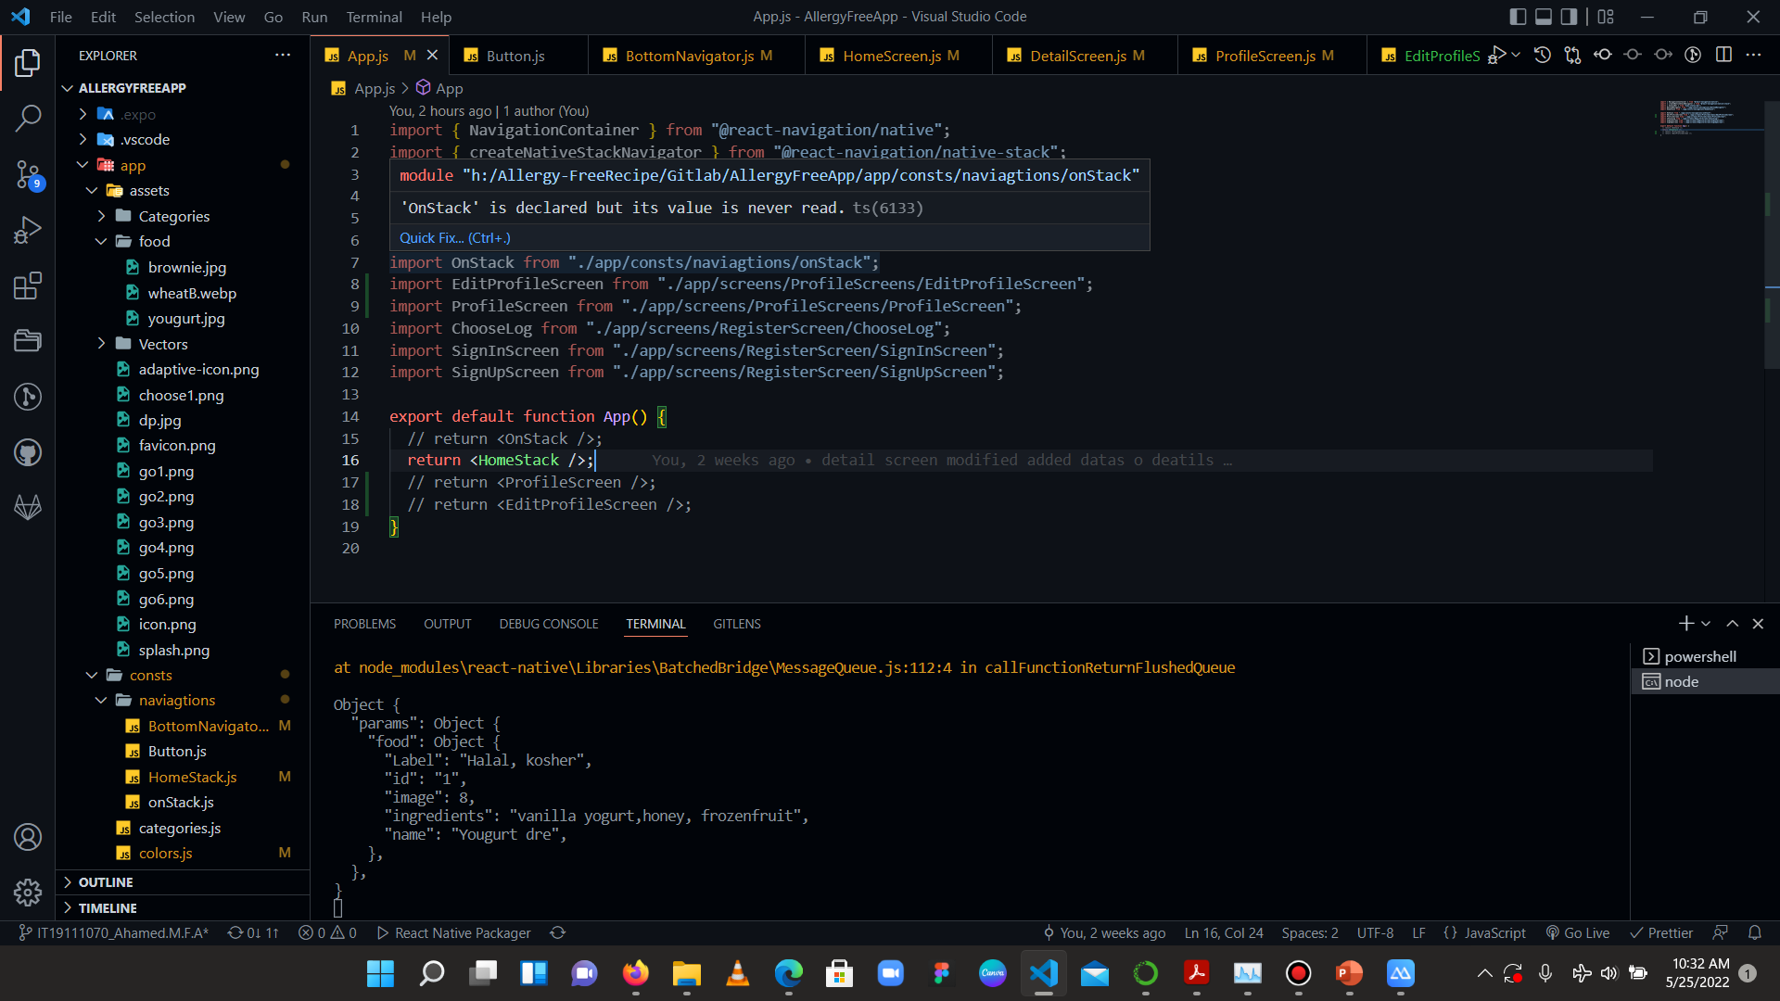
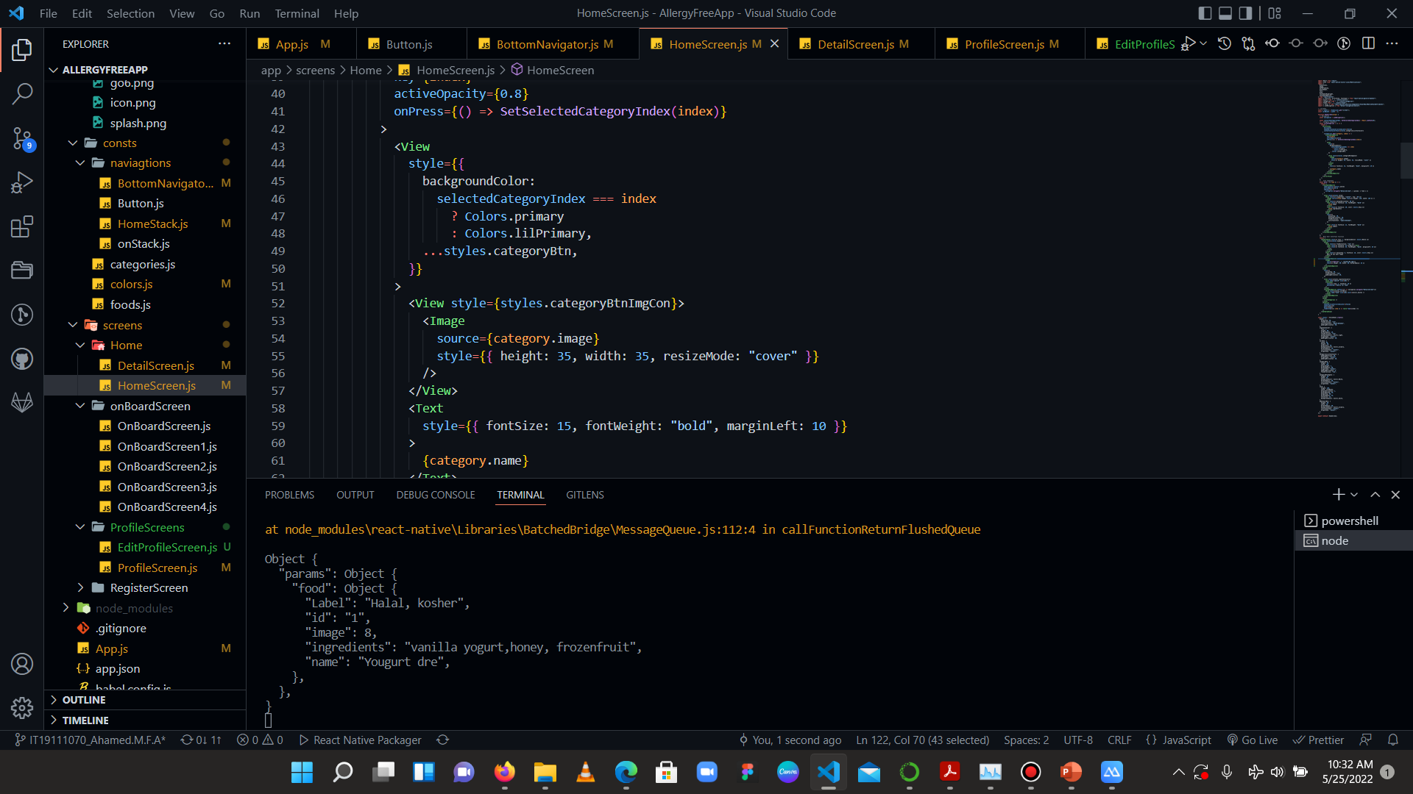
Completion of App Interfaces
Mobile app Development using React native
IT19111070 | M.F.A Ahamed | 2022-241 | Progress presentation1

Slide 27
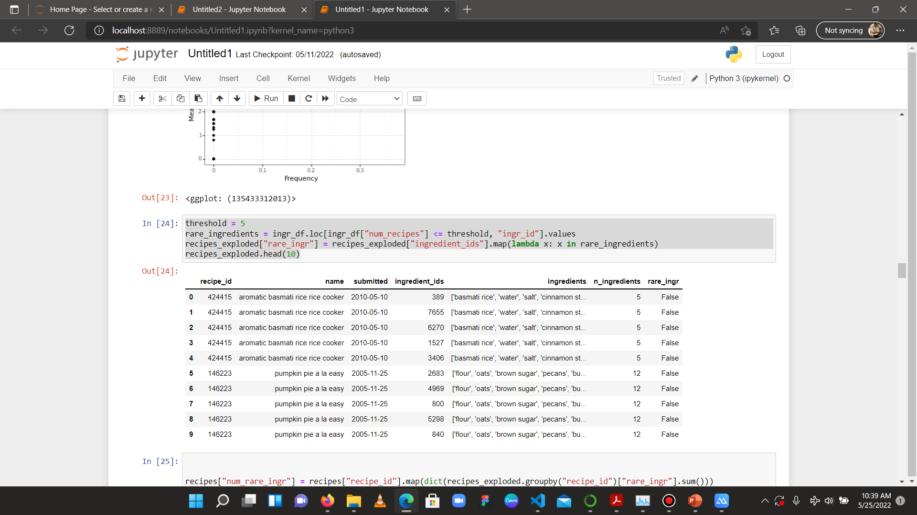
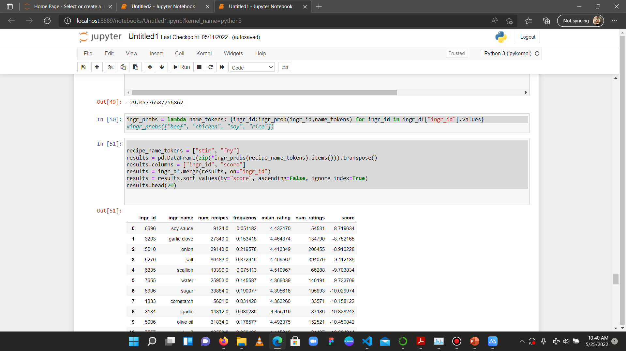
Completion of Model
Data analysis and model using Jupyter Notebook
IT19111070 | M.F.A Ahamed | 2022-241 | Progress presentation1

Slide 28
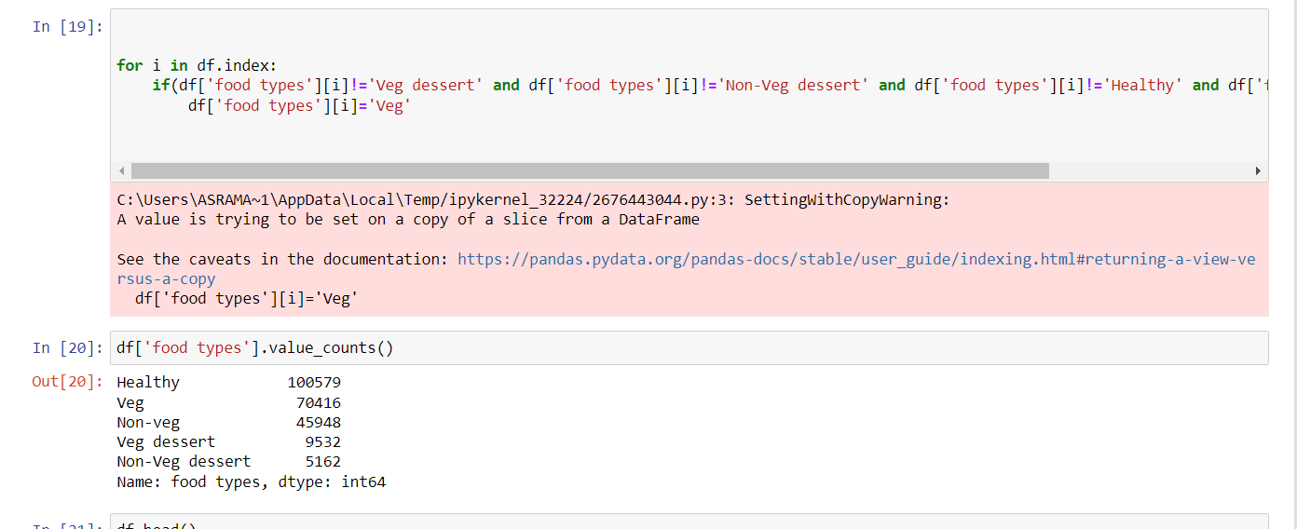
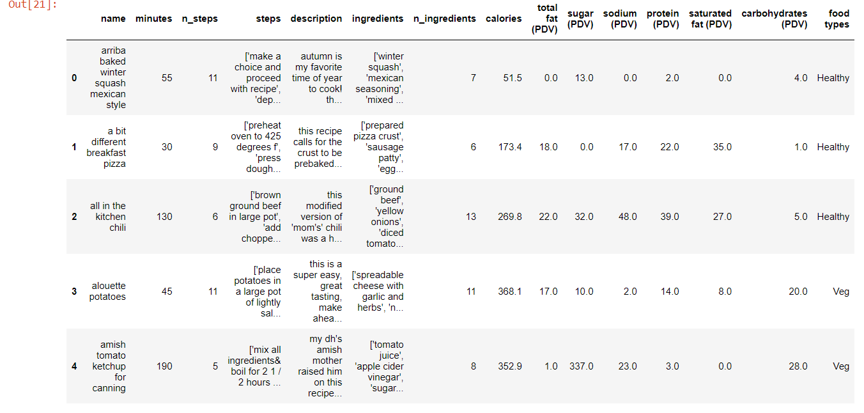
Completion of Model
Classifying datas veg, Non-veg Healthy
IT19111070 | M.F.A Ahamed | 2022-241 | Progress presentation1

Slide 29
Further Implementations
Participating users rated different foods and recipes with: “hate, dislike, neutral, like, love”.
The system then scores a recipe based on the average of all food item ratings of the recipe
IT19111070 | M.F.A Ahamed | 2022-241 | Progress presentation1

Slide 30
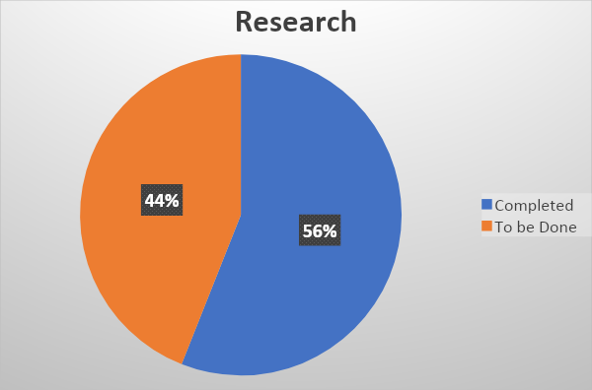
What is to be done
Deploy firebase function and the Implement the backends of the Implement Machine Learning Parts to the App
IT19111070 | M.F.A Ahamed | 2022-241 | Progress presentation1

Slide 31
Risk Mitigation
Problem | How Did I Overcome It
Collecting the data | Found the data from Keggle and did some page scrape from trusted websites
Finding the suitable Algorithm | Discussed with seniors and then gone through lots of research papers
So many errors in developing | Asked from forums and then got help from seniors
IT19111070 | M.F.A Ahamed | 2022-241 | Progress presentation1

Slide 32

Muhassan Faizal | IT19212050
Individual Component:
Tracking users calorie consumption and Prediction of Weight Management

Slide 33

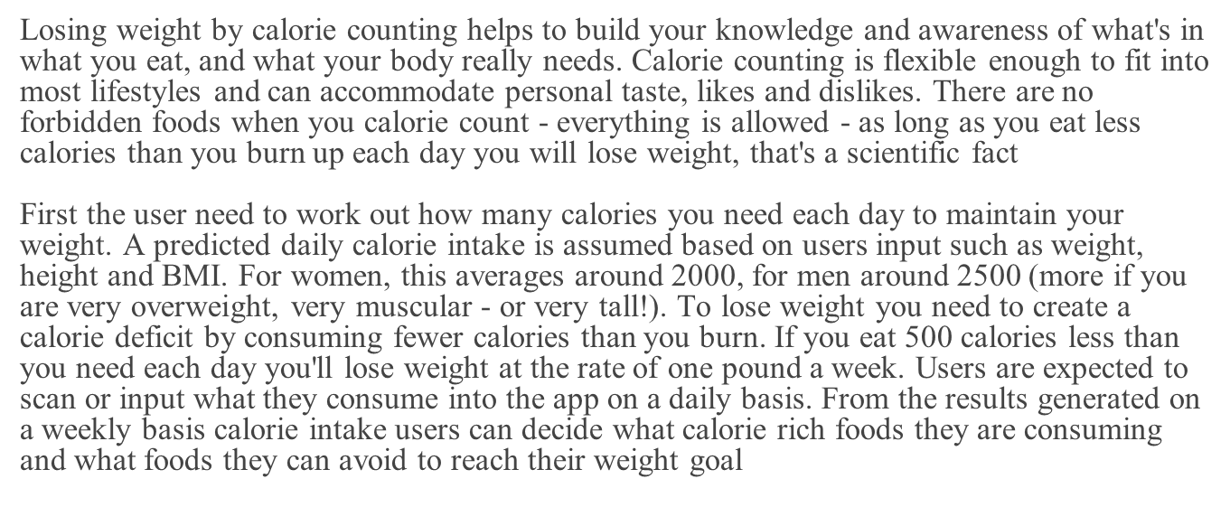

Slide 34

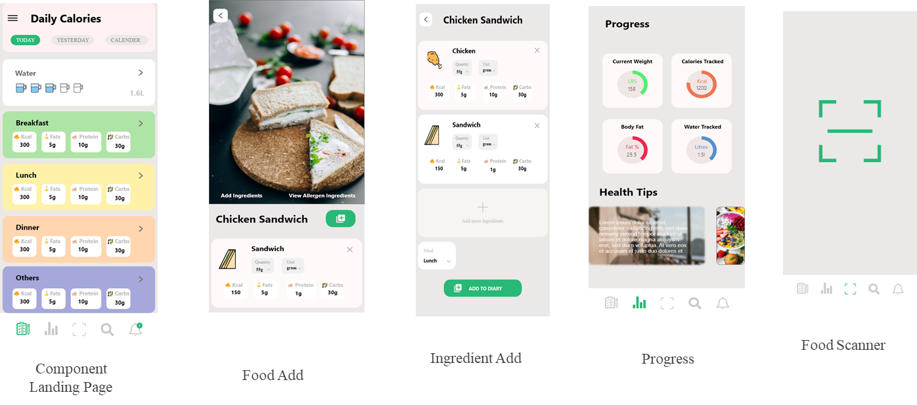

Slide 35

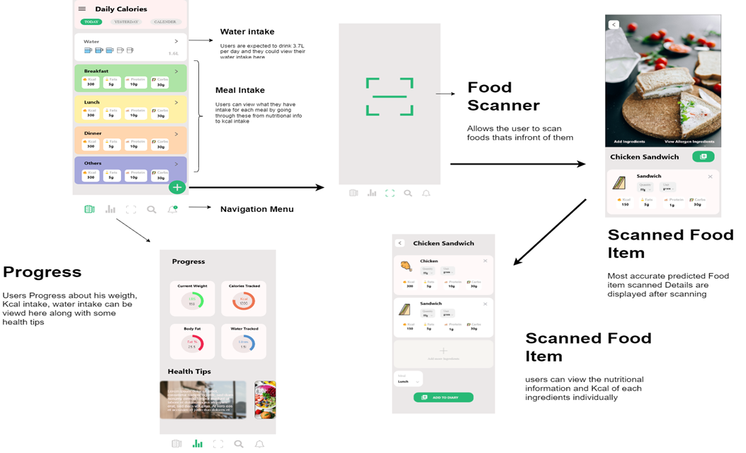

Slide 36
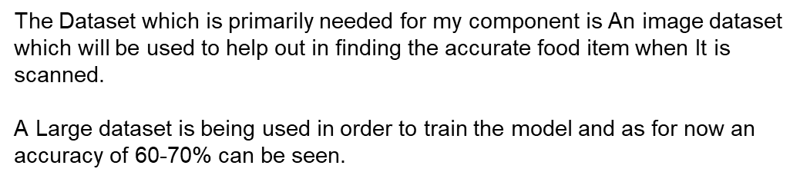
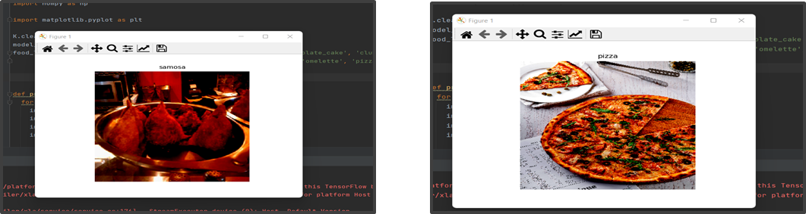

Slide 37

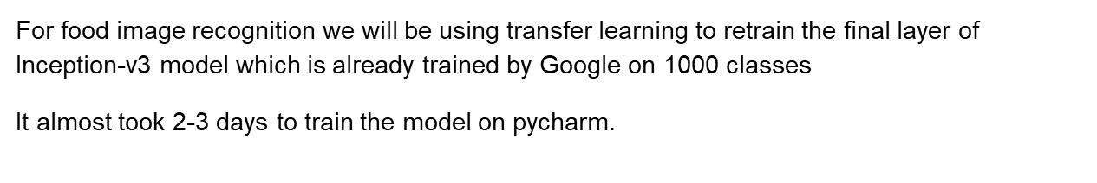


Slide 38



Slide 39

Chirathma V G B | IT19218090
Individual Component:
Predicting the time it takes to become obese and the risk of developing non-communicable diseases based on the user's daily meal plan

Slide 40
Objectives
Predicting the time it takes to become obese.
Predict the risk of developing non-communicable diseases based on the user's daily meal plan.

Slide 41
Absorb for fifty percent of the project
•Create a dataset.
•Calculate BMI value and daily needs based on the user’s biodata.
•Calculate the total calories the user gets per day.
•Calculate the time that the user becomes to obesity.

Slide 42

Research Methodology

Slide 43


Technologies that have used
Python
Json

Slide 44


This dataset contains details of nutritions of food items.

Slide 45




Figma Prototypes of the User Interfaces
1
2
3
4

Slide 46




Figma Prototypes of the User Interfaces
5
6
7
8

Slide 47

Output of the process

Slide 48
Future Plan
Predict the risk as a percentage what possibility to infected non-communicable diseases according to user’s meal plan.
Create a regression multi output artificial neural network model to Predict the risk as a percentage what possibility to infected non-communicable diseases according to user’s meal plan.
Create the front end.

Slide 49
Thank You

